Slide 1
I
RT
Klasifikasi Ruangan di Gedung Pascasarjana PENS
Catoer Ryando 1122800012
Prihantono 1122800017
Wilhan Jechovanda S 1122800018
Nur Rizky Romadhon 1223800002
15 April 2020
SENTRA ZAMRUD | RAPAT TERBUKA

Slide 2
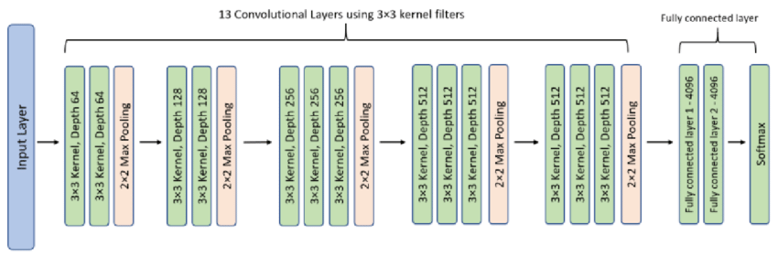
RT
Arsitektur VGG 16
II

Slide 3
III
Klasifikasi Gambar
RT
DATASET
Lift
Tangga
Koridor
Buntu
Orang
Pintu Darurat
Apar
Kelas

Slide 4
CODE
IV
# Training and testing folders
train_path = "D:/S2/S III/Computer Vision & Pengolahan Citra/Pratikum/cod/convis/dataset/training_set"
valid_path = "D:/S2/S III/Computer Vision & Pengolahan Citra/Pratikum/cod/convis/dataset/test_set"
Menentukan path (jalur) untuk folder pelatihan (train_path) dan folder validasi (valid_path). Ini adalah folder di mana gambar-gambar pelatihan dan validasi anda disimpan.

Slide 5
# Resize all the images to this
IMAGE_SIZE = [100, 100]
# Training config
epochs = 12
batch_size = 32
# Load pre-trained VGG16 model
vgg = VGG16(input_shape=IMAGE_SIZE + [3], weights='imagenet', include_top=False)
Ukuran gambar yang akan digunakan selama pelatihan (100x100 piksel) dalam variabel IMAGE_SIZE.
Memuat model vgg16 yang telah dilatih sebelumnya dari keras, dengan menambahkan lapisan flatten dan dense untuk melakukan klasifikasi.

Slide 6
# Create an instance of ImageDataGenerator
gen = ImageDataGenerator(
rotation_range=20,
width_shift_range=0.1,
height_shift_range=0.1,
shear_range=0.1,
zoom_range=0.2,
horizontal_flip=True,
vertical_flip=True,
rescale=1./255,
preprocessing_function=preprocess_input
)
Membuat instance dari imagedatagenerator untuk melakukan augmentasi data pada gambar pelatihan. Ini termasuk rotasi, pergeseran, pemotongan, flip horizontal dan vertikal, dan normalisasi.

Slide 7
# Create generators for training and validation
train_generator = gen.flow_from_directory(
train_path,
target_size=IMAGE_SIZE,
shuffle=True,
batch_size=batch_size,
)
valid_generator = gen.flow_from_directory(
valid_path,
target_size=IMAGE_SIZE,
shuffle=False,
batch_size=batch_size,
)
Membuat generator untuk data pelatihan dan validasi menggunakan imagedatagenerator. Ini akan menghasilkan batch gambar dengan augmentasi yang dapat digunakan selama pelatihan.

Slide 8
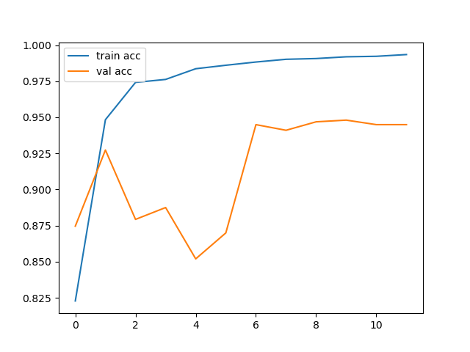
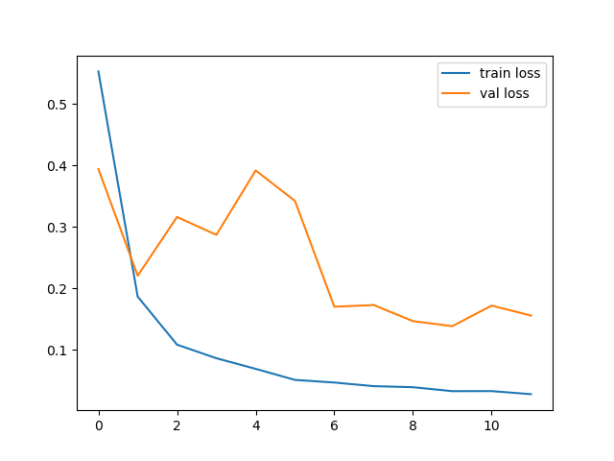
Epoch 1/12
182/182 [==============================] - 213s 1s/step - loss: 0.5526 - accuracy: 0.8228 - val_loss: 0.3939 - val_accuracy: 0.8746
Epoch 2/12
182/182 [==============================] - 135s 742ms/step - loss: 0.1862 - accuracy: 0.9483 - val_loss: 0.2203 - val_accuracy: 0.9273
Epoch 3/12
182/182 [==============================] - 138s 758ms/step - loss: 0.1081 - accuracy: 0.9742 - val_loss: 0.3159 - val_accuracy: 0.8793
Epoch 4/12
182/182 [==============================] - 134s 737ms/step - loss: 0.0860 - accuracy: 0.9762 - val_loss: 0.2867 - val_accuracy: 0.8875
Epoch 5/12
182/182 [==============================] - 130s 715ms/step - loss: 0.0687 - accuracy: 0.9836 - val_loss: 0.3916 - val_accuracy: 0.8520
Epoch 6/12
182/182 [==============================] - 127s 697ms/step - loss: 0.0507 - accuracy: 0.9861 - val_loss: 0.3418 - val_accuracy: 0.8699
Epoch 7/12
182/182 [==============================] - 129s 708ms/step - loss: 0.0465 - accuracy: 0.9883 - val_loss: 0.1698 - val_accuracy: 0.9449
Epoch 8/12
182/182 [==============================] - 126s 695ms/step - loss: 0.0406 - accuracy: 0.9902 - val_loss: 0.1726 - val_accuracy: 0.9410
Epoch 9/12
182/182 [==============================] - 130s 713ms/step - loss: 0.0389 - accuracy: 0.9907 - val_loss: 0.1464 - val_accuracy: 0.9469
Epoch 10/12
182/182 [==============================] - 130s 716ms/step - loss: 0.0325 - accuracy: 0.9919 - val_loss: 0.1382 - val_accuracy: 0.9480
Epoch 11/12
182/182 [==============================] - 127s 697ms/step - loss: 0.0325 - accuracy: 0.9923 - val_loss: 0.1717 - val_accuracy: 0.9449
Epoch 12/12
182/182 [==============================] - 120s 659ms/step - loss: 0.0276 - accuracy: 0.9935 - val_loss: 0.1554 - val_accuracy: 0.9449
Final training accuracy = 0.9934561848640442
Final validation accuracy = 0.9449218511581421
V
RT

Slide 9
VI
HASIL KLASIFIKASI
1/1 [==============================] - 0s 161ms/step
Image: apar.jpeg, Predicted Class: apar
1/1 [==============================] - 0s 31ms/step
Image: koridor1.jpg, Predicted Class: koridor
1/1 [==============================] - 0s 32ms/step
Image: koridor2.jpeg, Predicted Class: koridor
1/1 [==============================] - 0s 35ms/step
Image: lift1.jpg, Predicted Class: lift
1/1 [==============================] - 0s 37ms/step
Image: lift2.jpg, Predicted Class: lift
1/1 [==============================] - 0s 38ms/step
Image: lift3.jpeg, Predicted Class: lift
1/1 [==============================] - 0s 37ms/step
Image: lift3.jpg, Predicted Class: lift
1/1 [==============================] - 0s 31ms/step
Image: orang1.jpg, Predicted Class: orang
1/1 [==============================] - 0s 39ms/step
Image: pintu_darurat.jpg, Predicted Class: pintu_ruang

Slide 10
Terima Kasih

